Slide 1


Claude Shannon:
A Curious Mind Believing in the Power of Information
提高 2301 班 张禹阳
May. 3, 2025

Slide 2
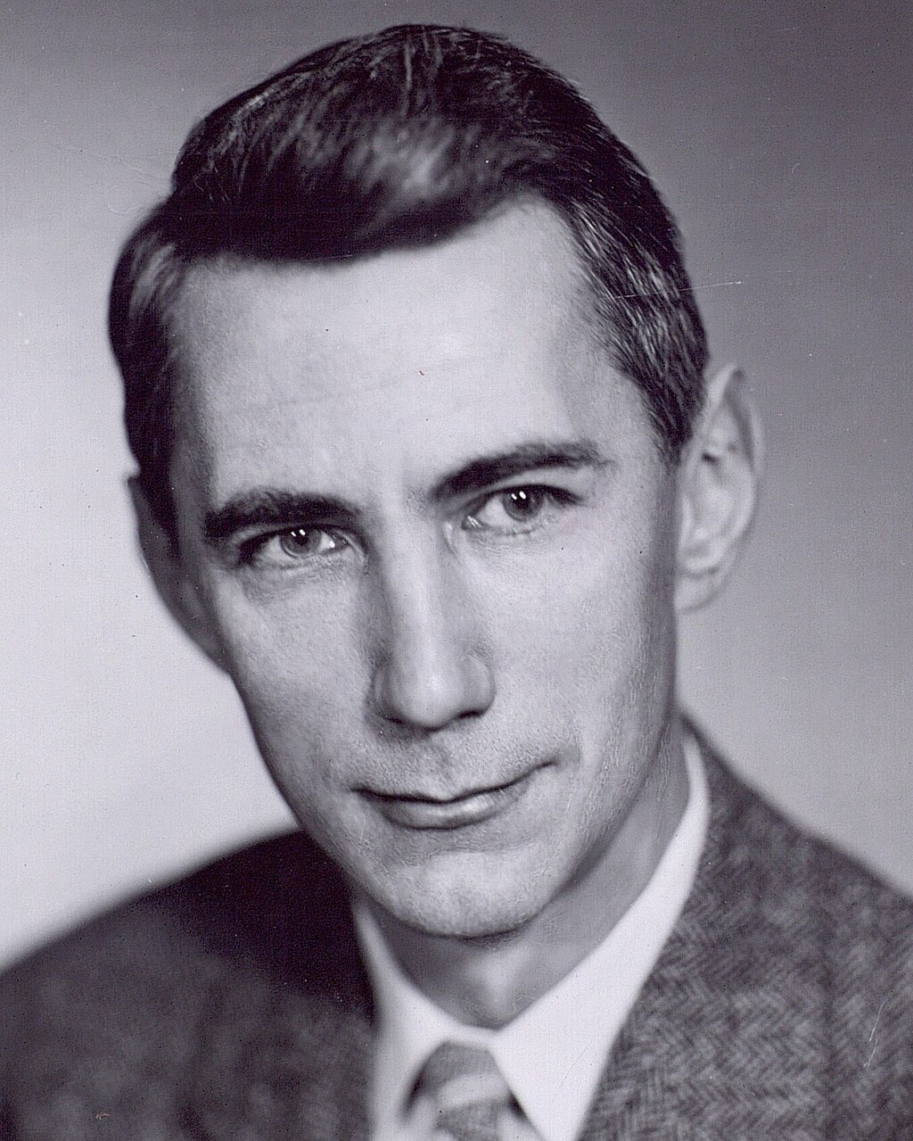
Table of Contents
Life Journey
Deep Dive: The Dawn of Information Theory
Personal Reflections & Takeaways
Conclusion & Legacy

Slide 3
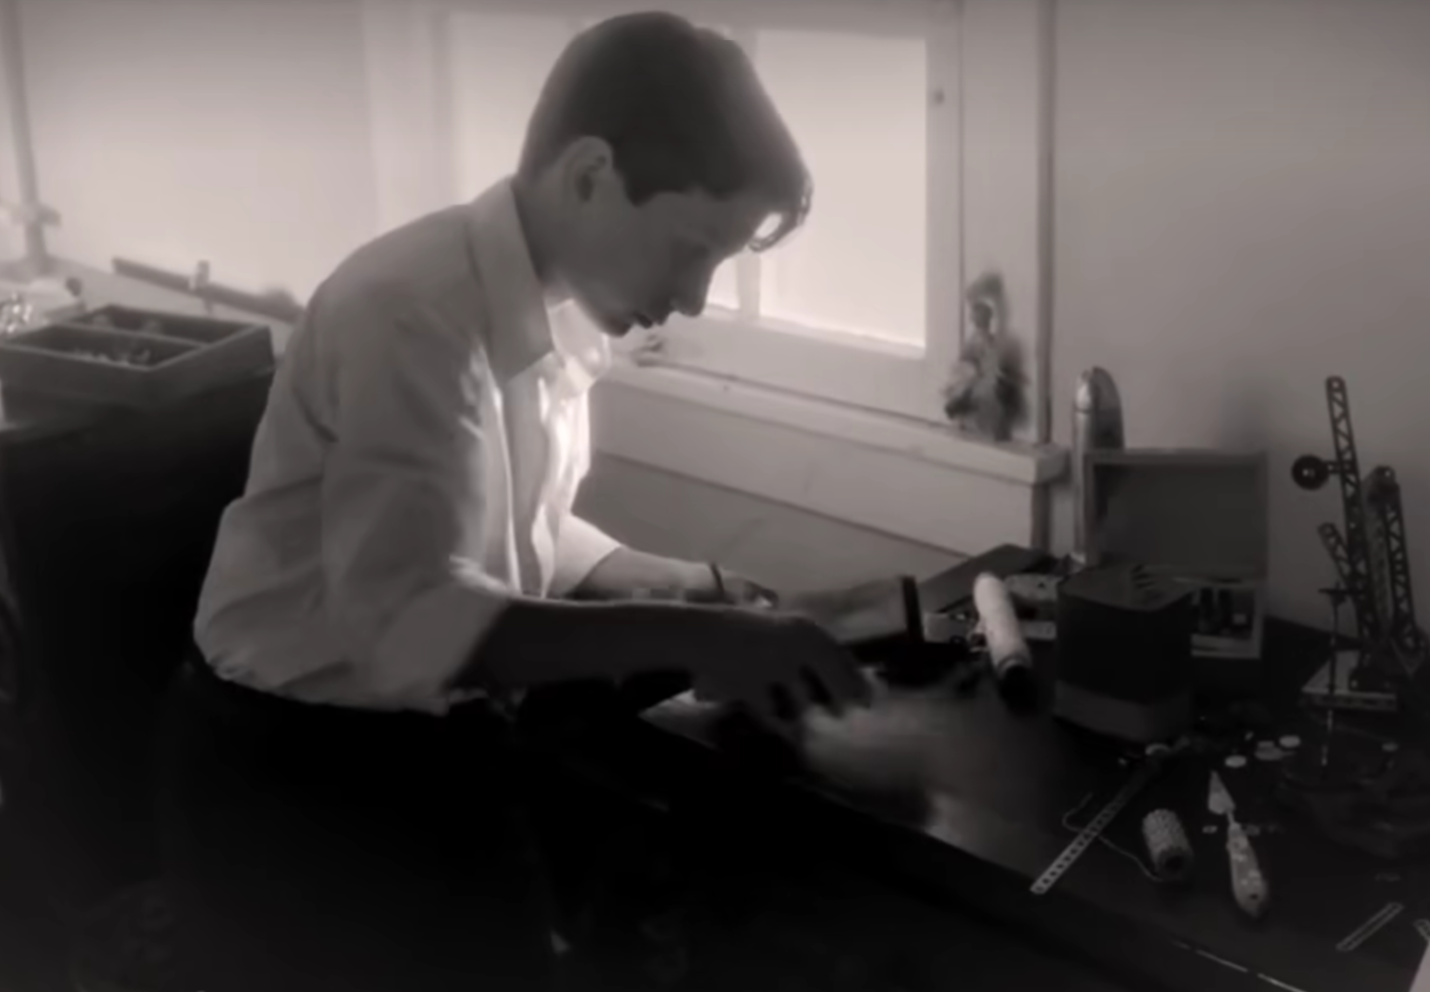
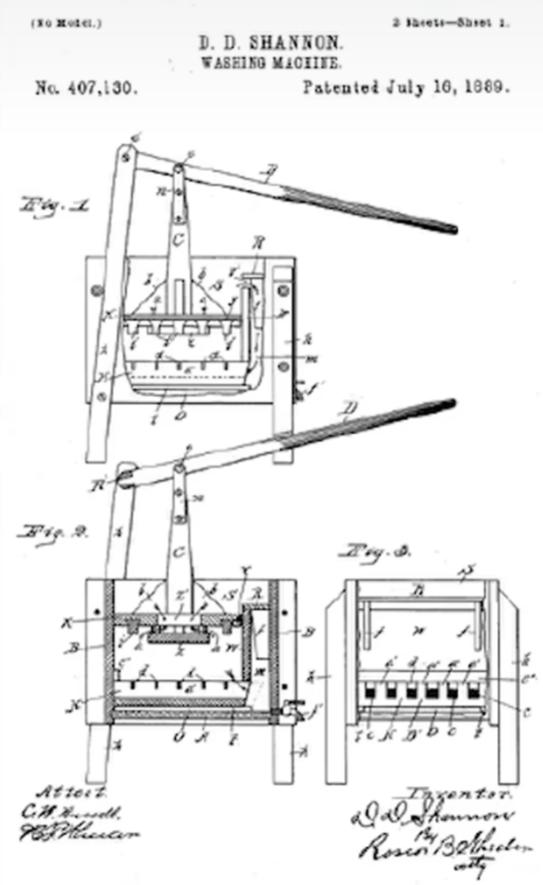
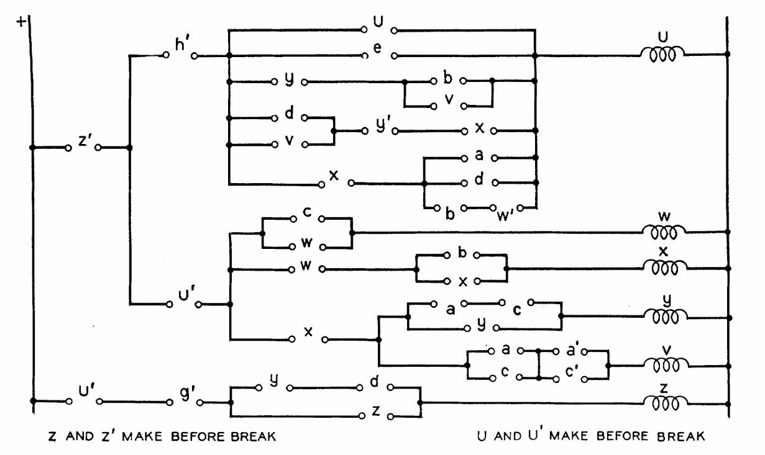
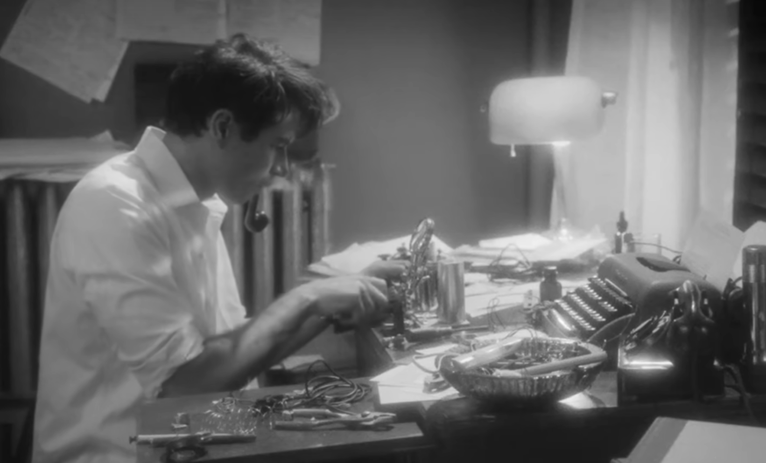
Life Journey
Early Life
Born in Michigan
Showed an inclination towards mechanical and electrical things
Constructed models of planes, a radio-controlled model boat, a barbed-wired telegraph system to a friend’s house
Academic Excellence
Doubled-majored in mathematics & EE in UMich
MIT master’s thesis on Boolean logic and circuits, a revolutionary work for switching circuit theory

Slide 4
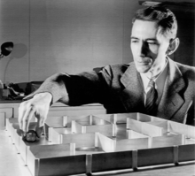
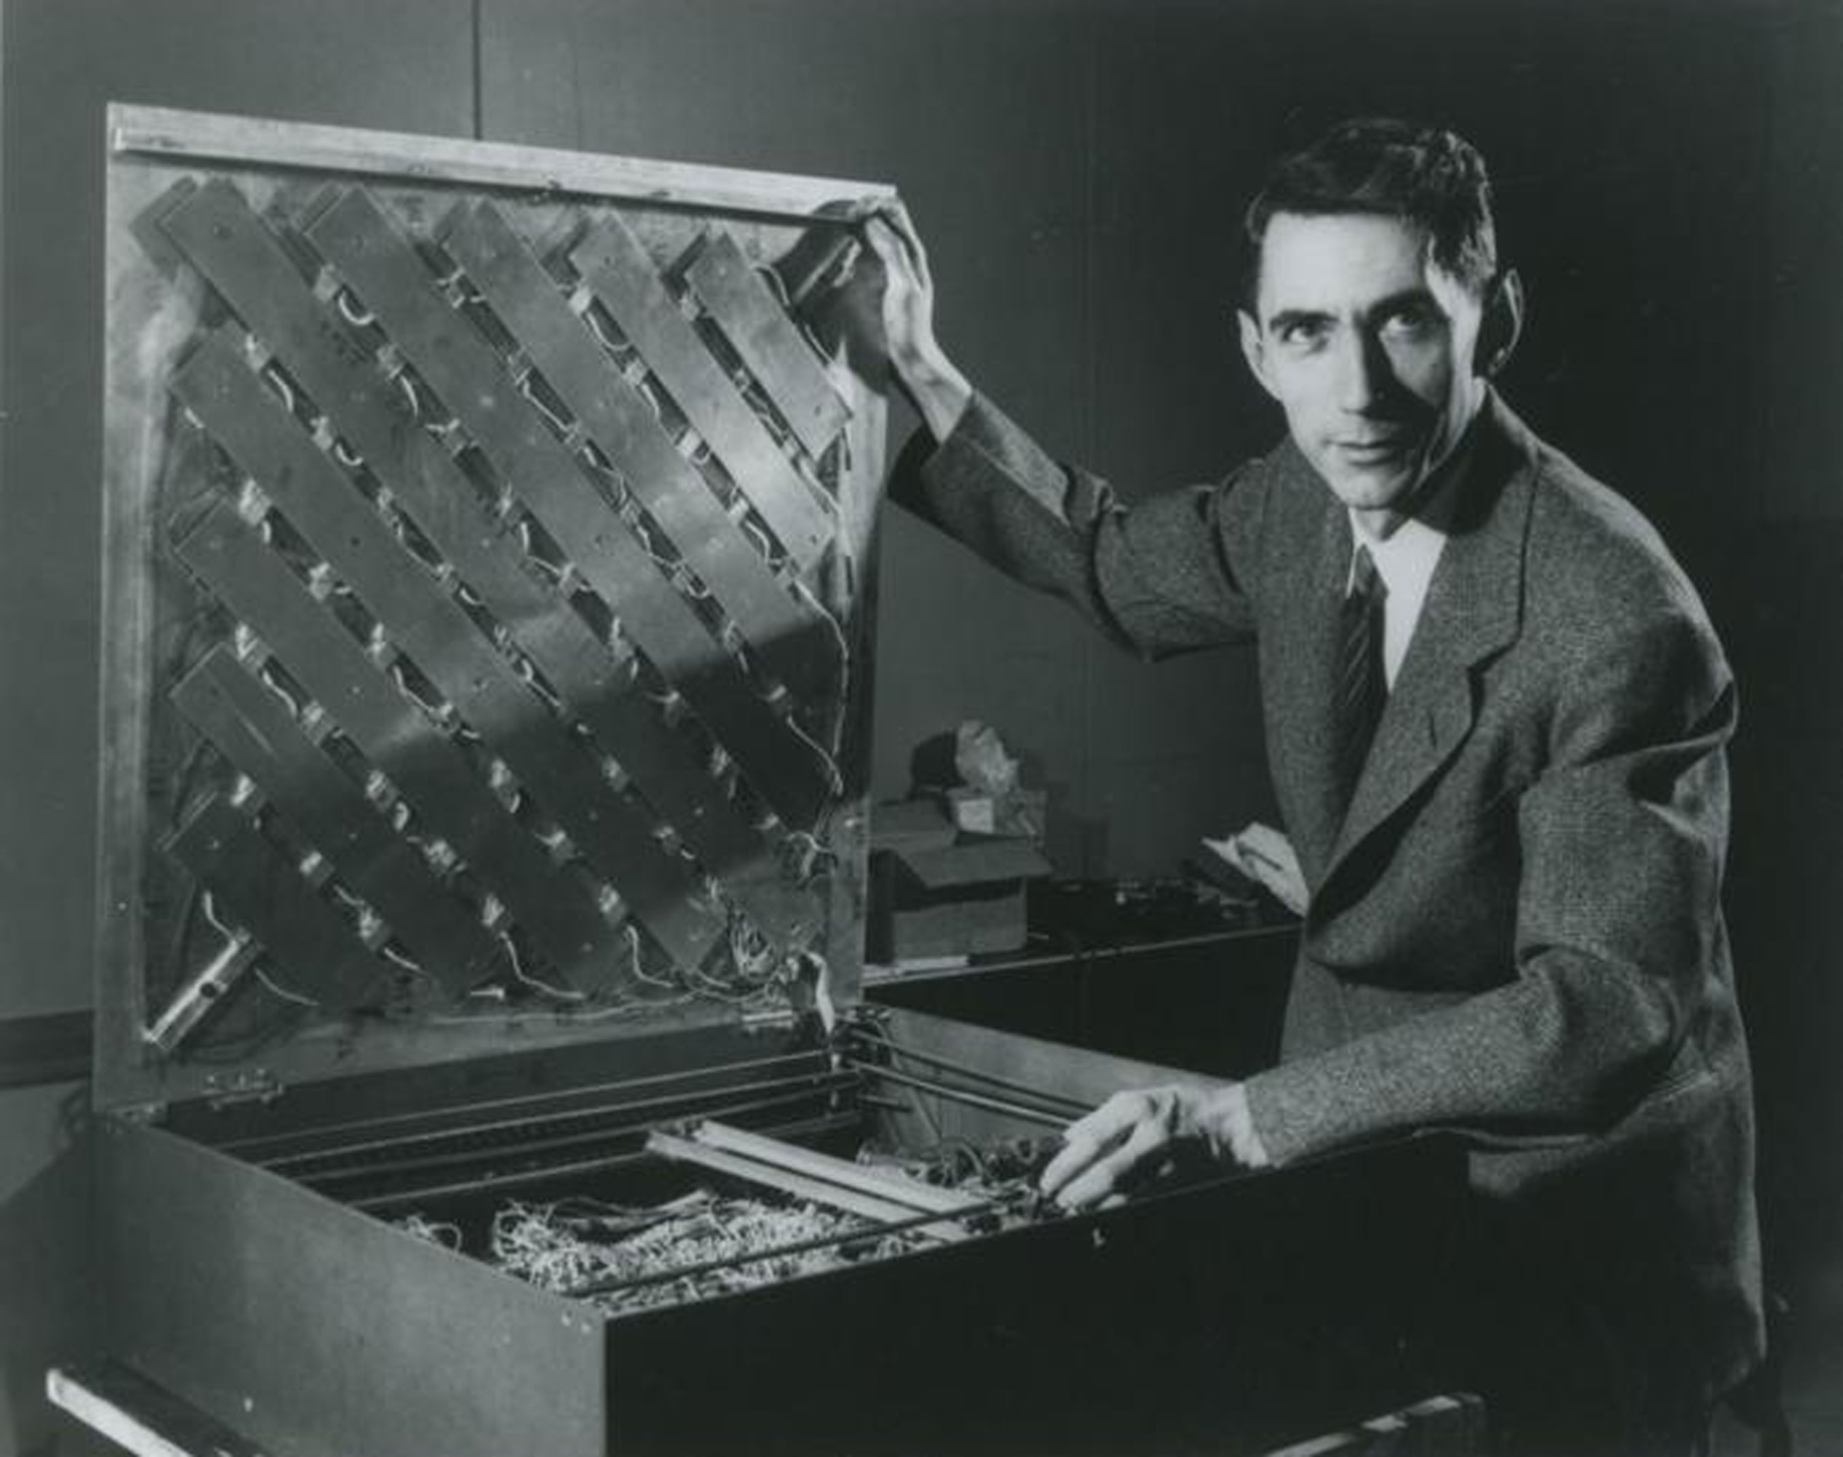
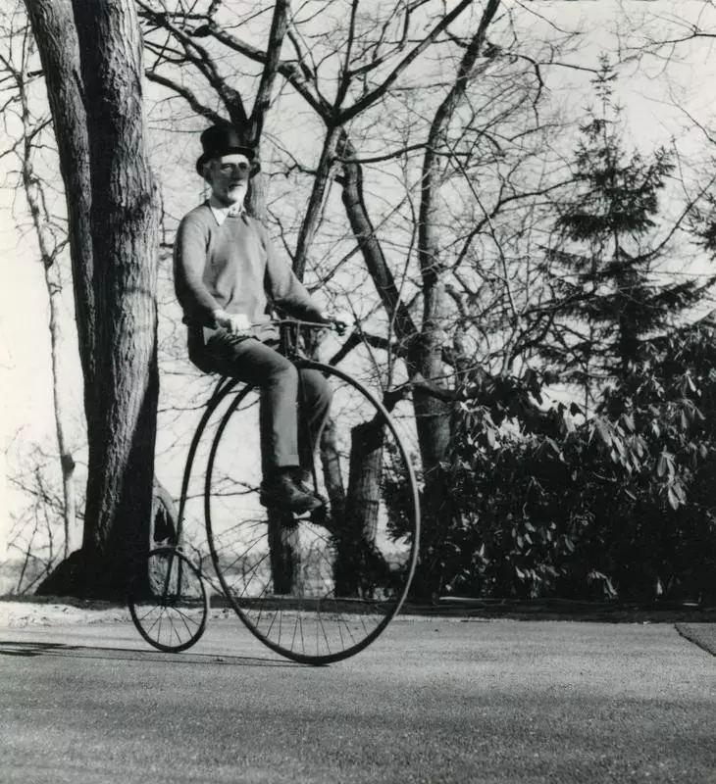
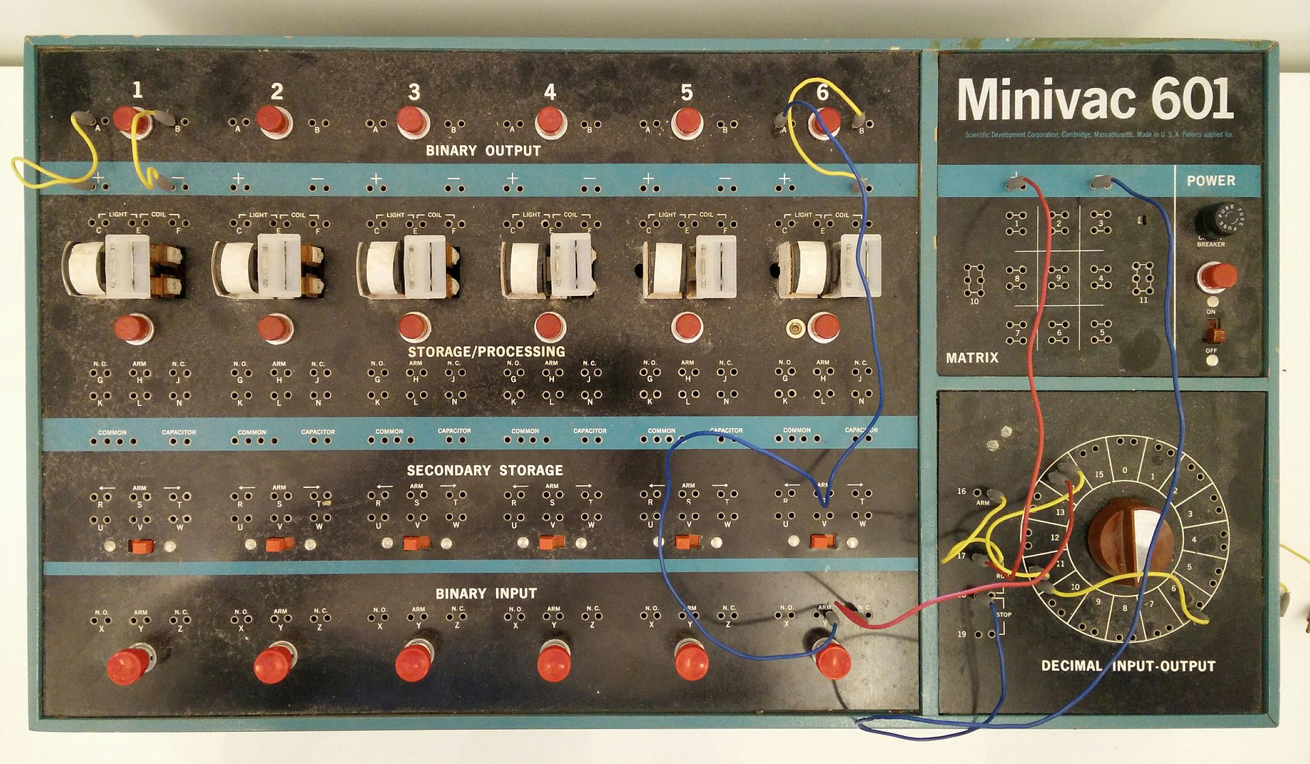
Bell Labs Era
Worked on fire-control system and cryptography during WWII
Developed Information Theory
Inspiration for AI: Built a learning machine named Theseus
Later Years
Developed Alzheimer’s disease and spent the last few years of his life in a nursing house
Hobbies & Inventions
Interested in juggling, unicycling, and chess
Invented juggling machines, a device that could solve the Rubik’s cube puzzle, a digital computer trainer……

Slide 5
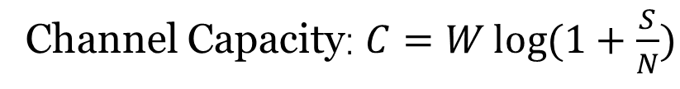
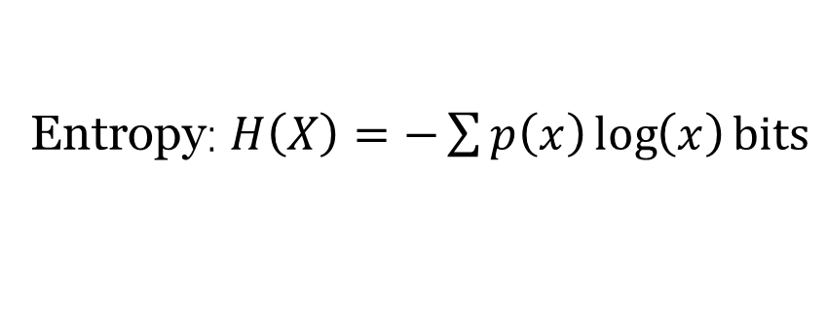
Deep Dive: The Dawn of Information Theory
Historical Context
Advancements in telecommunications faced limitations:
Noise
Efficiency
Security
Interdisciplinary Approach
Mathematics-Physics-Engineering
Entropy: $H\left(X\right)=−\sum{p\left(x\right)\log\left(x\right)}bits$
Core Motivation
Shannon aimed to answer a question: “How can information be transmitted reliably despite noise and uncertainty?”
Channel Capacity: $C=W\log{(1+\frac{S}{N})}$
Redundancy & Error Correction

Slide 6
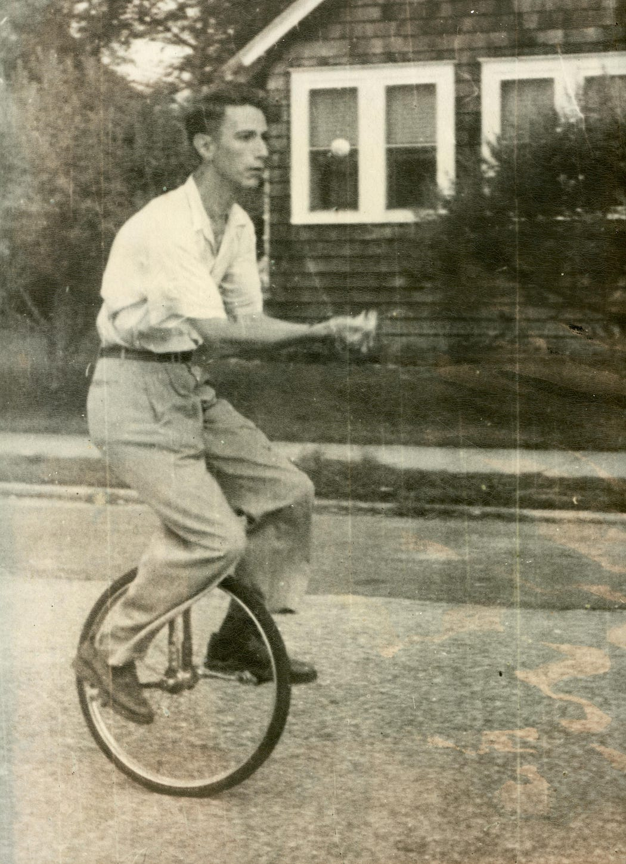
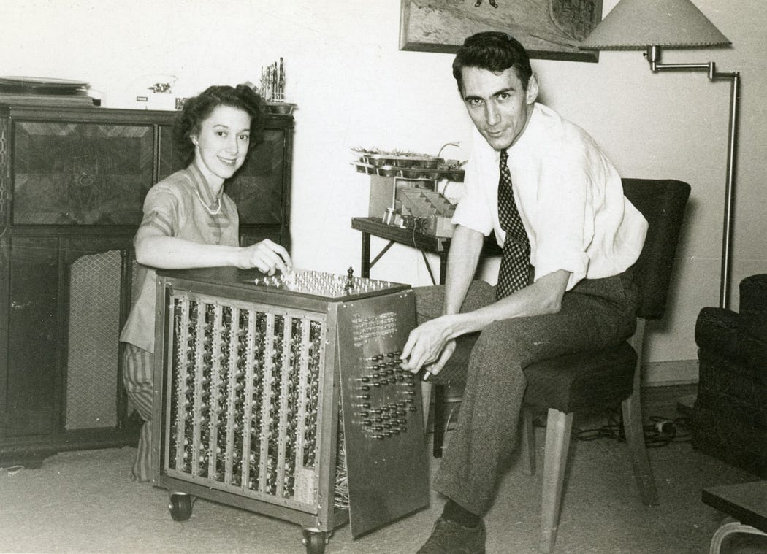
Personal Reflections & Takeaways
Embrace Disciplinarity
Shannon’s blend of math, physics, and engineering shows innovation thrives at intersections
Stay Curious and Playful
Shannon’s hobbies mirrored his scientific ethos-balancing rigor with creativity
He famously rode a unicycle through Bell Labs while tossing balls

Slide 7
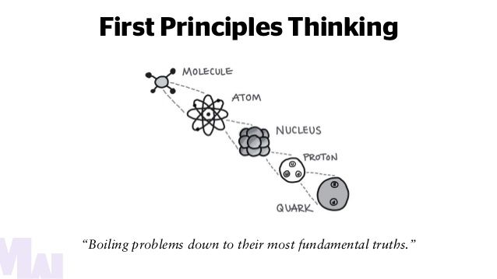
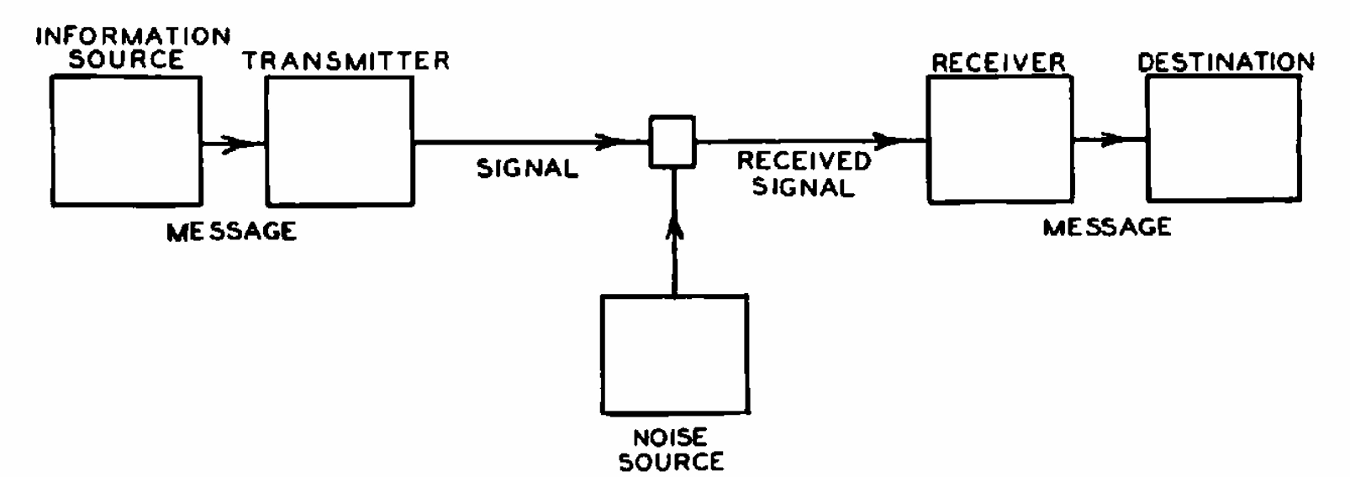
Pursue Simplicity
“If you can bring this problem down into the main issues, you can see more clearly what you’re trying to do.”

Slide 8
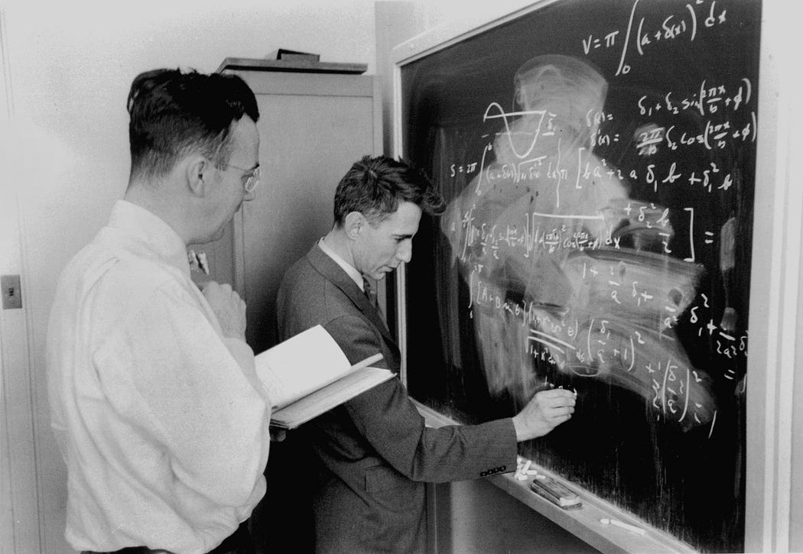
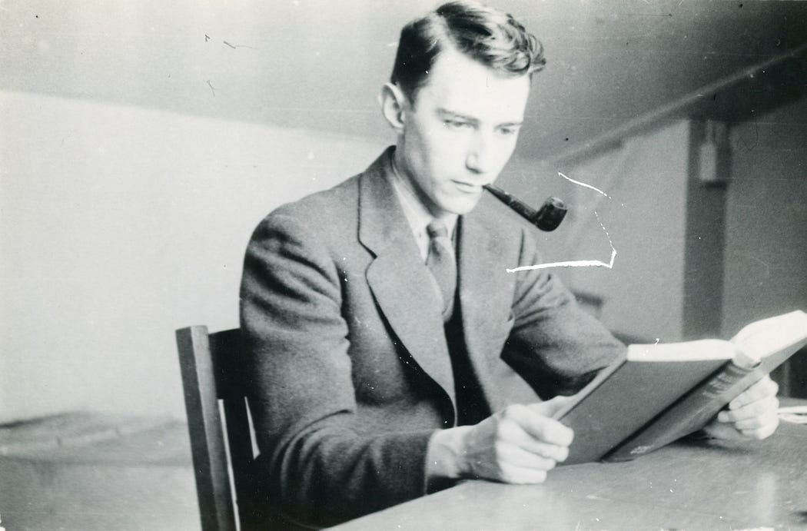
Focus on Big Pictures First
In his mathematical work, Shannon had a quality of leaping right to the central insight and leaving the details to be filled in later
Value Persistence
Shannon wasn’t working on information theory full-time for 10 years
But his endurance in sticking with it yielded the most important work he’d ever produce

Slide 9
Conclusion & Legacy
Curious Mind
jugglers/unicyclists/gadgeteers/
first-rate chess players/codebreakers/
expert stock pickers/amateur poets
Power of Information
From information theory to AI, his ideas underpin modern technologies
“I just wondered how things were put together.”
— Claude Shannon

